Slide 1

AI Based Behavioral Finance Analyzer
Leveraging Sentiment Analysis and Stock Price Forecasting for Market Psychology Insights
Presented by: Aashvi Jain 229310185

Slide 2
INTRODUCTION
Behavioral finance combines psychology with finance to understand market anomalies.
Sentiment plays a vital role in investor decisions—especially emotions like fear and greed, and herd mentality that drive stock prices significantly.
This project fuses Natural Language Processing and Time Series Analysis to market sentiment and predict movements. By analyzing key patterns and relationships

Slide 3
Motivation & Objectives
Problem Statement:
The aim of this project is to create an AI-Based Behavioral Finance Analyzer that implements NLP sentiment analysis as well as stock market forecasting to study the intricate behavioral patterns that shape the market.
The primary research objectives include:
• Collecting and preprocessing real-world financial textual data and stock prices.
• Training a DistilBERT-based sentiment classifier to categorize sentiments accurately as positive or negative.
• Developing an LSTM model for predicting future stock prices based on historical data.
• Integrating sentiment predictions with stock price forecasts on a time-synchronized axis.
• Visualizing and evaluating the behavioral relationship between public sentiment and stock price changes.

Slide 4
Technologies Used
The project utilizes a combination of AI, data science, and deep learning tools:
Python: Primary programming language used for development.
Transformers (Hugging Face): For loading and fine-tuning the DistilBERT model.
TensorFlow/Keras: For developing the LSTM-based stock price prediction model.
Scikit-learn & VADER: For data preprocessing, labeling, and evaluation.
Pandas & NumPy: For data handling and transformations.
Matplotlib & Seaborn: For visualization of trends, heatmaps, and analytical insights.
Yahoo Finance / Kaggle APIs: For stock price and financial sentiment data acquisition.

Slide 5
System Architecture

Slide 6
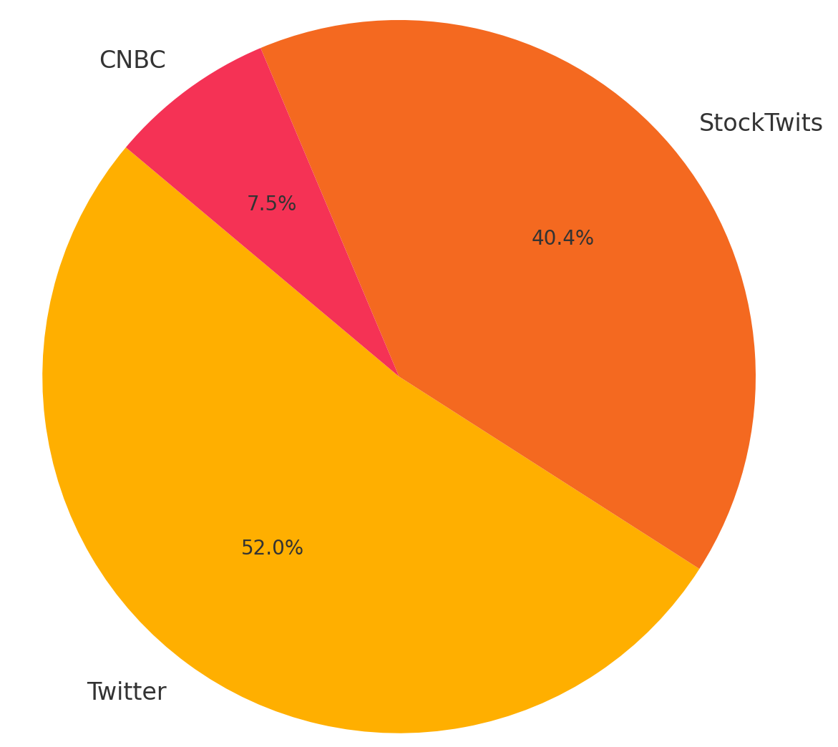
Dataset Description & Preprocessing
Sentiment Sources:
CNBC – (2800,4)
Twitter – (30000,4)
Stock Twits – (15000,4)
Stock Data:
Yahoo Finance (Adjusted Closing prices)
Preprocessing:
Standardizing columns
Cleaning text
Sentiment labeling using VADER (0 = Fear, 1 = Greed)
Merging on timestamps

Slide 7
Sentiment Analysis – DistilBERT Model
DistilBERT model chosen for it’s efficiency and performance.
Fine-tuned on merged dataset labeled using VADER
Imported DistilBertTokenizer, TFDistilBertForSequenceClassification, and AdamWeightDecay
Train – test split = 80:20
Evaluation:
Training Accuracy: 97.28%,
Validation Accuracy : 80%

Slide 8
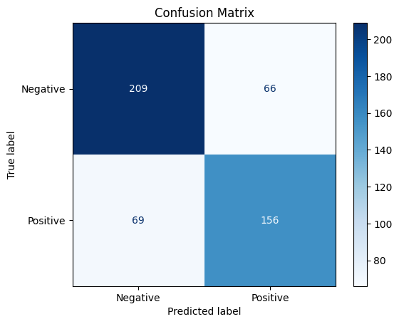
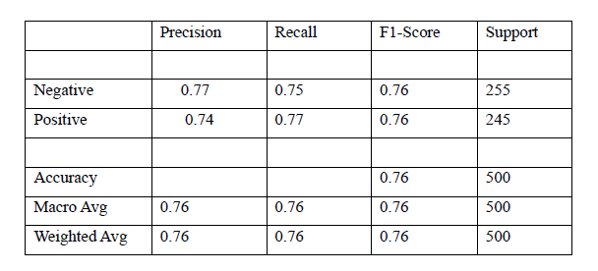

Slide 9
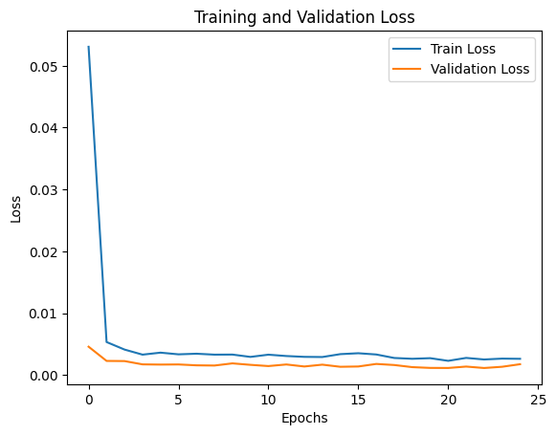
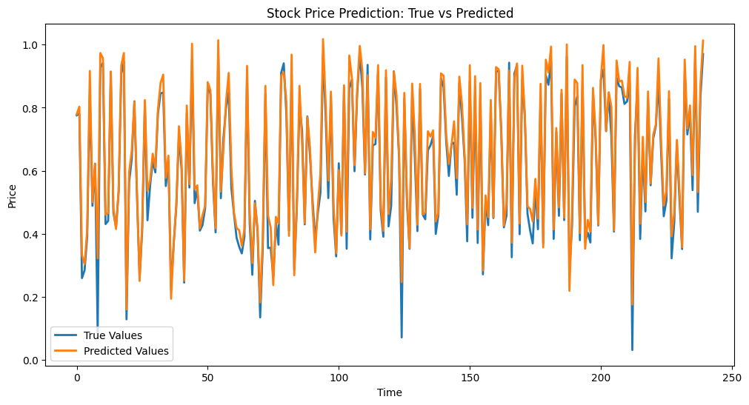
Stock Price Prediction - LSTM Model
LSTM trained on normalized Adjusted Close prices
Predicts next-day price from historical data
Evaluation Metrics:
MSE =
RMSE =

Slide 10
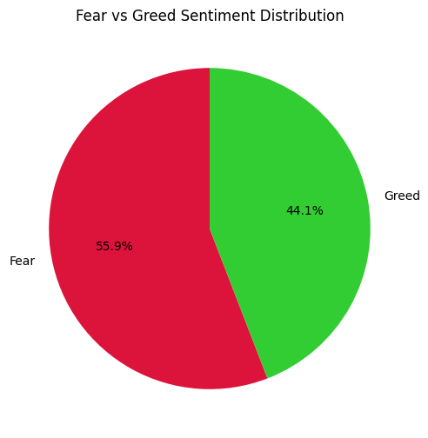
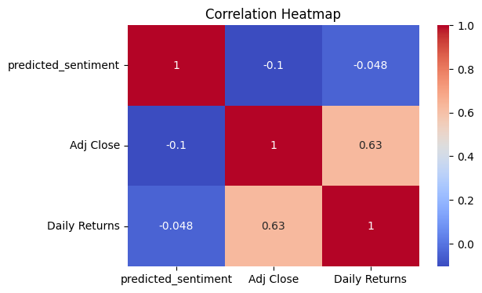
Behavioral Correlation Analysis
Merge sentiment and stock data by date
Analyze if fear/greed correlates with price change

Slide 11
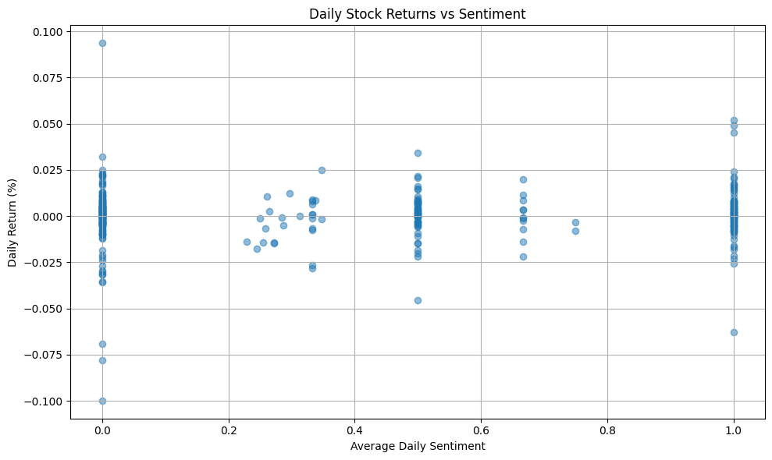
Visual Insights
Adjusted close price vs sentiment over time
Adjusted close price vs sentiment over time

Slide 12
Conclusion
The integration of sentiment analysis and price forecasting shows how AI can replicate investor psychology and identify behavior-driven trends.
proves that Sentiment significantly affects market trends
AI can capture and model these psychological effects
The project not only achieved its goals but also introduced a data-driven approach to comprehending irrational behaviors in markets.

Slide 13
References
Tools (Hugging Face, TensorFlow, etc.)
Datasets (Yahoo Finance, Twitter API)
Journal / Conference Papers
[1] S. R. Subha and M. Archana, “Impact of Behavioral Finance in Investment Decision Making,” International Journal of Management and Social Science Research Review, vol. 1, no. 5, pp. 81–92, Dec. 2016.
[2] D. Xu, Z. Du, and M. Cao, “Deep learning-based stock price movement prediction using sentiment analysis from social media,” Scientific Reports, vol. 13, article no. 18263, 2023
[3] A. Kumar and N. Goyal, “Stock Price Prediction Using LSTM and Sentiment Analysis,” Proceedings of the IEEE International Conference on Artificial Intelligence and Machine Learning (ICAIML), India, 2021.
[4] J. Bollen, H. Mao, and X. Zeng, “Twitter Mood Predicts the Stock Market,” Journal of Computational Science, vol. 2, no. 1, pp. 1–8, 2011.
Web
[1] Behavioral Finance: Theories and Evidence, Cannon Financial Institute. Last Accessed: April 22, 2025.
[2] DistilBERT: Smaller, Faster, Cheaper, Hugging Face Blog. Last Accessed: April 22, 2025

